Slide 1
Views in SQL
A view is a “virtual” table that is derived from other tables
Allows for limited update operations
  Since the table may not physically be stored
Allows full query operations

Slide 2
SQL Views: An Example
Create a view for Department Managers:
CREATE VIEW MANAGER AS
SELECT FNAME, LNAME, DName, Dnumber, SALARY
FROM EMPLOYEE, DEPARTMENT
WHERE SSN=MGRSSN AND DNO=DNUMBER;
Find employees who earn more than their managers
SELECT E.FNAME, E.LNAME
FROM EMPLOYEE E, MANAGER M
WHERE E.DNO=M.DNUMBER AND E.SALARY > M.SALARY;
When no longer needed, a view can be dropped:
DROP VIEW MANAGER;

Slide 3
View Implementation
There are two ways to implement a view:
Approach 1: Query modification
  Modify the view query into a query on the underlying base tables
  Example:
  SELECT * FROM Manager WHERE Salary > 100000
  becomes
  SELECT Fname, Lname, Dname, Dnumber, Salary
  FROM EMPLOYEE, DEPARTMENT
  WHERE SSN=MgrSSN AND Salary > 100000
  Disadvantage:
    Inefficient for views defined via complex queries

Slide 4
View Implementation
Approach 2: View materialization
  Involves physically creating and keeping a temporary table
  Concerns:
    Maintaining correspondence between the base table and the view when the base table is updated
ORACLE
    CREATE MATERIALIZED VIEW or CREATE SNAPSHOT

Slide 5
Update Views
Update on a view can be implemented by mapping it to an update on the underlying base table
    UPDATE MANAGER
    SET Salary = 1.1*Salary
    WHERE Dname = ‘Research’;
  Becomes:
    UPDATE EMPLOYEE
    SET Salary = 1.1*Salary
    WHERE SSN in (SELECT MgrSSN
    FROM DEPARTMENT
    WHERE DName = ‘Research’);
Updating views involving joins are not always possible
  Views defined using groups and aggregate functions are not updateable
For mySQL, the keyword “WITH CHECK OPTION” must be added to the view definition if the view is to be updated

Slide 6
Stored Procedures in MySQL
A stored procedure contains a sequence of SQL commands stored in the database catalog so that it can be invoked later by a program
Stored procedures are declared using the following syntax:
  Create Procedure <proc-name>
  (param_spec₁, param_spec₂, …, param_spec_{n} )
  begin
  -- execution code
  end;
  where each param_spec is of the form:
  [in | out | inout] <param_name> <param_type>
  in mode: allows you to pass values into the procedure,
  out mode: allows you to pass value back from procedure to the calling program

Slide 7
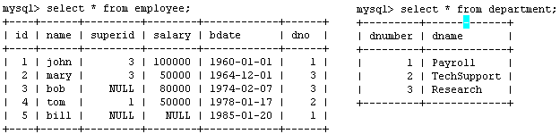
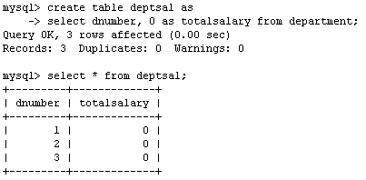
Example
Suppose we want to keep track of the total salaries of employees working for each department
We need to write a procedure to update the salaries in
the deptsal table

Slide 8
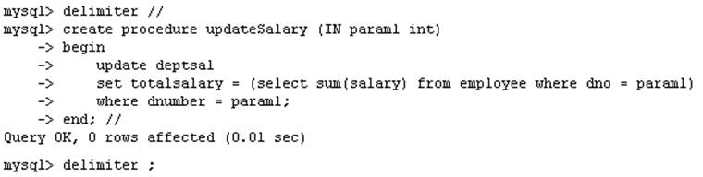
Example
Step 1: Change the delimiter (i.e., terminating character) of SQL statement from semicolon (;) to something else (e.g., //)
So that you can distinguish between the semicolon of the SQL statements in the procedure and the terminating character of the procedure definition

Slide 9
Example
Step 2:
Define a procedure called updateSalary which takes as input a department number.
The body of the procedure is an SQL command to update the totalsalary column of the deptsal table.
Terminate the procedure definition using the delimiter you had defined in step 1 (//)

Slide 10
Example
Step 3: Change the delimiter back to semicolon (;)

Slide 11
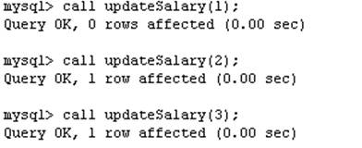
Example
Step 4: Call the procedure to update the totalsalary for each department

Slide 12
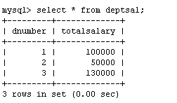
Example
Step 5: Show the updated total salary in the deptsal table

Slide 13
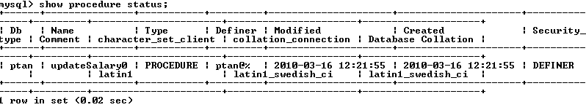

Stored Procedures in MySQL
Use show procedure status to display the list of stored procedures you have created
Use drop procedure to remove a stored procedure

Slide 14
Stored Procedures in MySQL
You can declare variables in stored procedures
You can use flow control statements (conditional IF-THEN-ELSE or loops such as WHILE and REPEAT)
MySQL also supports cursors in stored procedures.
  A cursor is used to iterate through a set of rows returned by a query so that we can process each individual row.
To learn more about stored procedures, go to:
  http://www.mysqltutorial.org/mysql-stored-procedure-tutorial.aspx

Slide 15
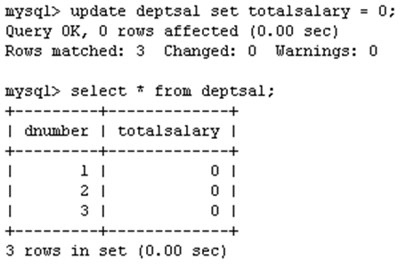
Example using Cursors
The previous procedure updates one row in deptsal table based on input parameter
Suppose we want to update all the rows in deptsal simultaneously
  First, let’s reset the totalsalary in deptsal to zero

Slide 16
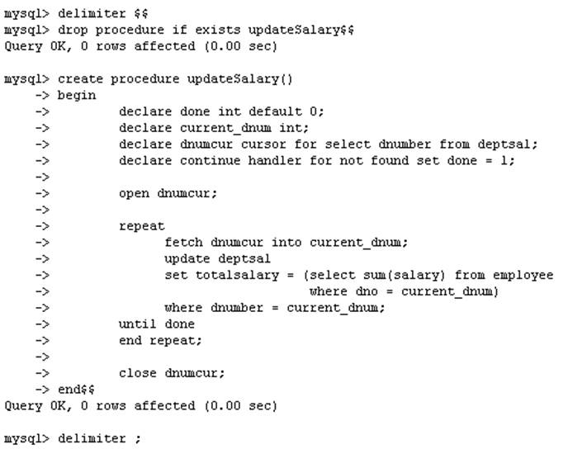
Example using Cursors
Drop the old procedure
Use cursor to iterate the rows

Slide 17
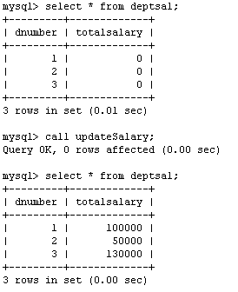
Example using Cursors
Call procedure

Slide 18
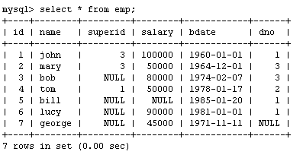
Another Example
Create a procedure to give a raise to all employees

Slide 19
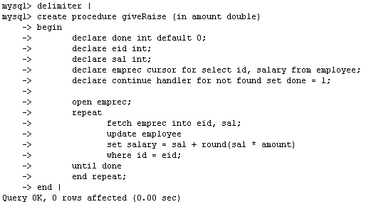
Another Example

Slide 20
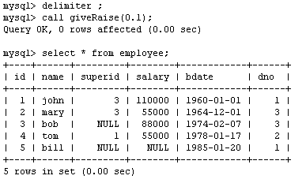
Another Example

Slide 21
Functions
Functions are declared using the following syntax:
  function <function-name> (param_spec₁, …, param_spec_{k})
  returns <return_type>
  [not] deterministic allow optimization if same output
  for the same input (use RAND not deterministic )
  Begin
  -- execution code
  end;
  where param_spec is:
  [in | out | in out] <param_name> <param_type>
  You need ADMIN privilege to create functions on mysql-user server

Slide 22
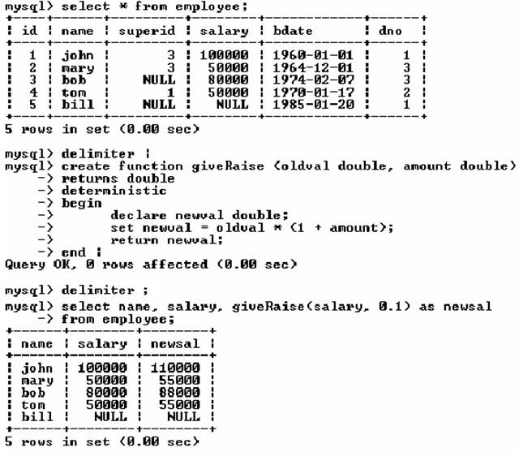
Example of Functions

Slide 23
Example of Functions

Slide 24
SQL Triggers
To monitor a database and take a corrective action when a condition occurs
  Examples:
    Charge $10 overdraft fee if the balance of an account after a withdrawal transaction is less than $500
    Limit the salary increase of an employee to no more than 5% raise
CREATE TRIGGER trigger-name
trigger-time trigger-event
ON table-name
FOR EACH ROW
trigger-action;
  trigger-time ∈ {BEFORE, AFTER}
  trigger-event ∈ {INSERT,DELETE,UPDATE}

Slide 25
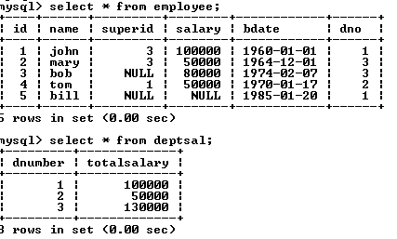
SQL Triggers: An Example
We want to create a trigger to update the total salary of a department when a new employee is hired

Slide 26
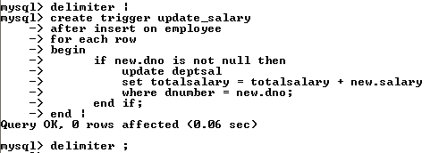
SQL Triggers: An Example
Create a trigger to update the total salary of a department when a new employee is hired:
The keyword “new” refers to the new row inserted

Slide 27
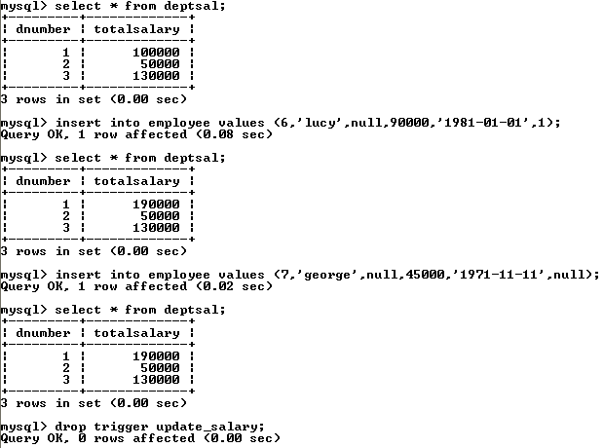
SQL Triggers: An Example
totalsalary increases by 90K
totalsalary did not change

Slide 28
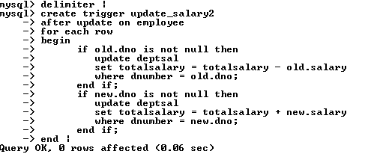
SQL Triggers: An Example
A trigger to update the total salary of a department when an employee tuple is modified:

Slide 29
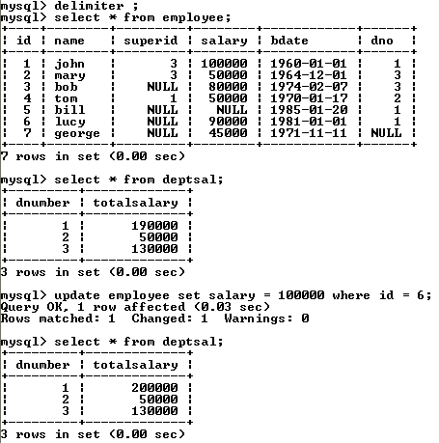
SQL Triggers: An Example

Slide 30
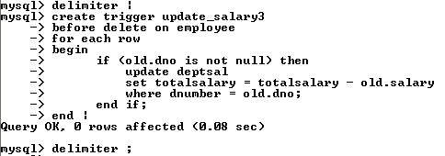
SQL Triggers: An Example
A trigger to update the total salary of a department when an employee tuple is deleted:

Slide 31
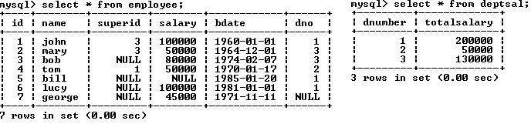
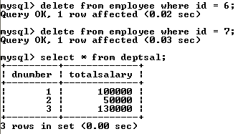
SQL Triggers: An Example

Slide 32
SQL Triggers
To list all the triggers you have created:
  mysql> show triggers;

